Slide 1
Status Update
JCIT Meeting
May 13, 2022

Slide 2
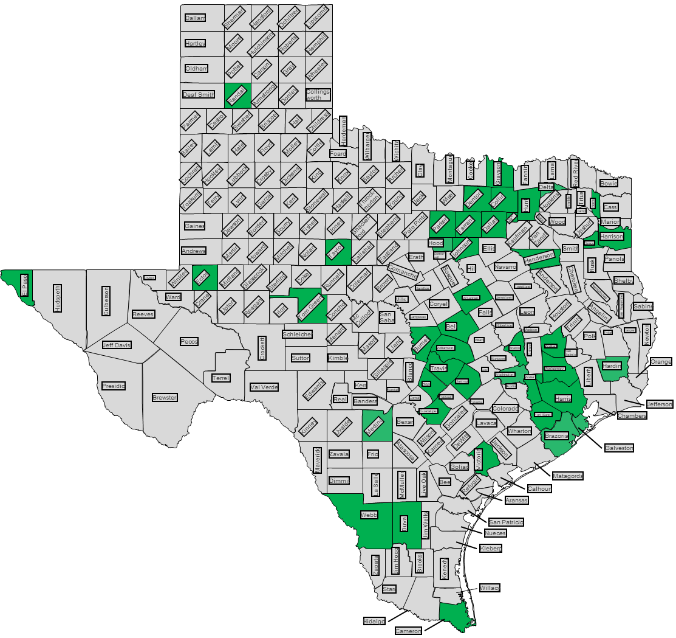
Transaction Volume: 2/1/22 to 4/30/22
Program Continues to Thrive
Over 550k user accounts created
Over 40k envelopes processed daily
Averages more than $14 million collected for state/counties each month
JP Update
166 precincts across 43 counties live
14 active/pending engagements
Notes:
Average over 105k JP filings per month (a little more than 9% of the overall volume)

Slide 3
Redaction Utilization
Solution has been utilized over half a million times
Over 20k monthly utilization average
  57+% increase from 2021
Service implemented and available within 3 EFSPs
  eFileTexas
  FileTime
  ProDoc
57.7% Increase

Slide 4
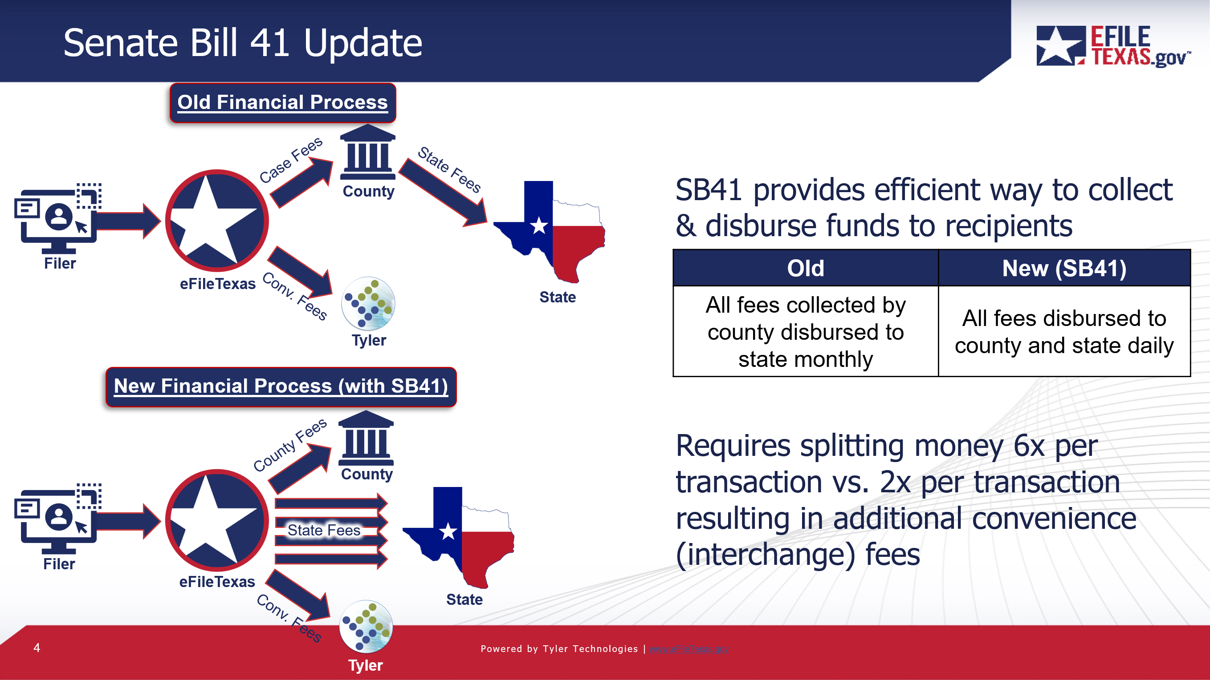
Senate Bill 41 Update
eFileTexas contract allows Tyler to charge a $1 minimum convenience fee rate for situations like this
Implementing the $1 minimum convenience fee covers additional interchange fees that were a result of SB41
$1 minimum fee was implemented on May 1st as a short-term solution
Situation | Convenience Fee Rate
Convenience fee is < $1 | $1.00
Convenience fee is > $1 | 2.89% of total fee
Long-term solution: Tyler to become a Payment Facilitator (PayFac)
Operating as a PayFac will allow Tyler to collect the funds throughout the day and do a daily split/disbursement to the recipients (vs. by transaction), reducing the interchange fees assessed

Slide 5
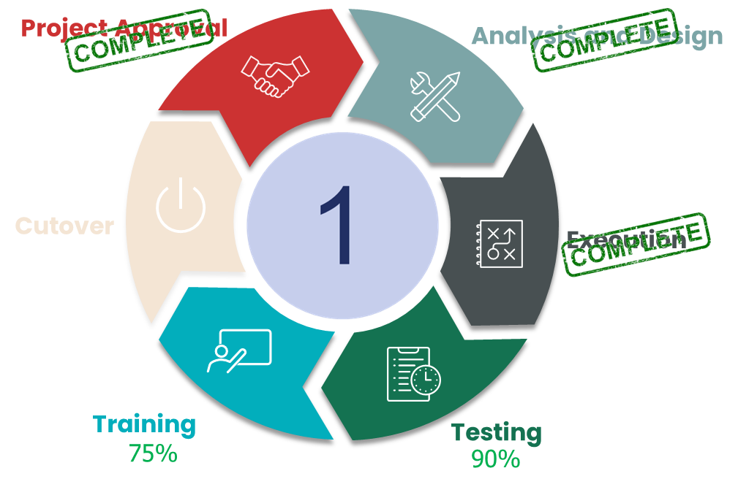
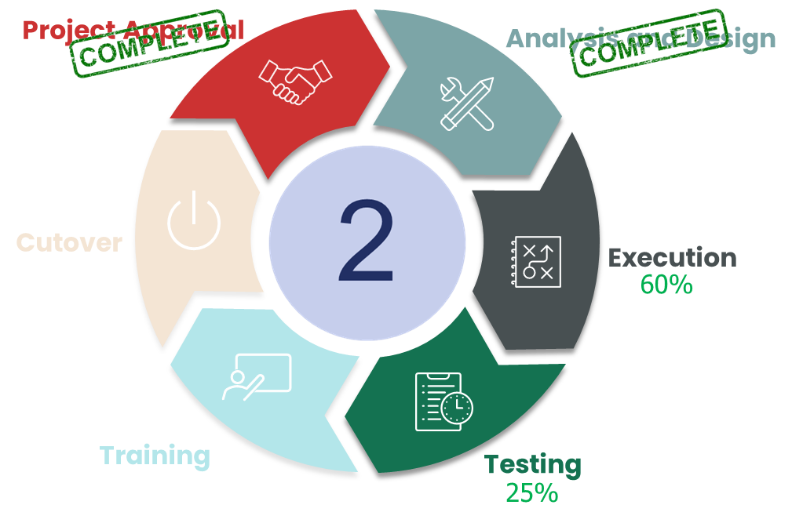
eFileTexas 2.0 - Project Update
User Acceptance Testing in progress; expect to complete by 6/3
End user training for filers begins early June
Cycle 1 Production cutover scheduled for 7/16/22
Cycle 2 Execution phase has started
  Development at 50%
Notes:
Notable cycle 1 enhancements include – ECF 5.0, bulk review actions, chat-bot help for support, enhanced machine learning for redaction and efile analytics – our reporting and metrics dashboard solution

Slide 6
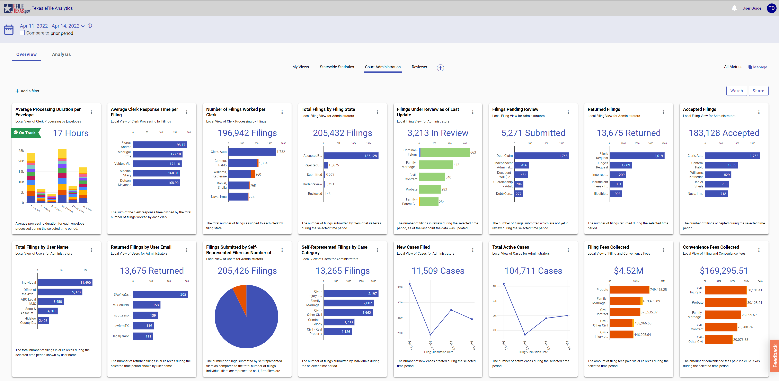


eFile Analytics Product Rollout
Implementation Schedule
Wave 1 (State Admins and pilot group) l Live
Wave 2 (500K+ Population) | Live
Wave 3 (100K – 499K Population) | Live
Wave 4 (50K – 99K Population) | Live
Wave 5 (20K – 49K Population) - 5/19/2022
Wave 6 (< 20K Population) - 6/6/2022
Clint Ludwig, Tarrant County Clerk - Chief Deputy, on eFile Analytics:
“It has given me visibility into things that allows me to better manage my office. This includes:
being able to see how many envelopes are submitted for certain case types
the average clerk response time per filing
the amount of rejected filings and how they are broken down
The new solution gives me an opportunity to manage my staff more efficiently.”
Notes:
Terry

Slide 7
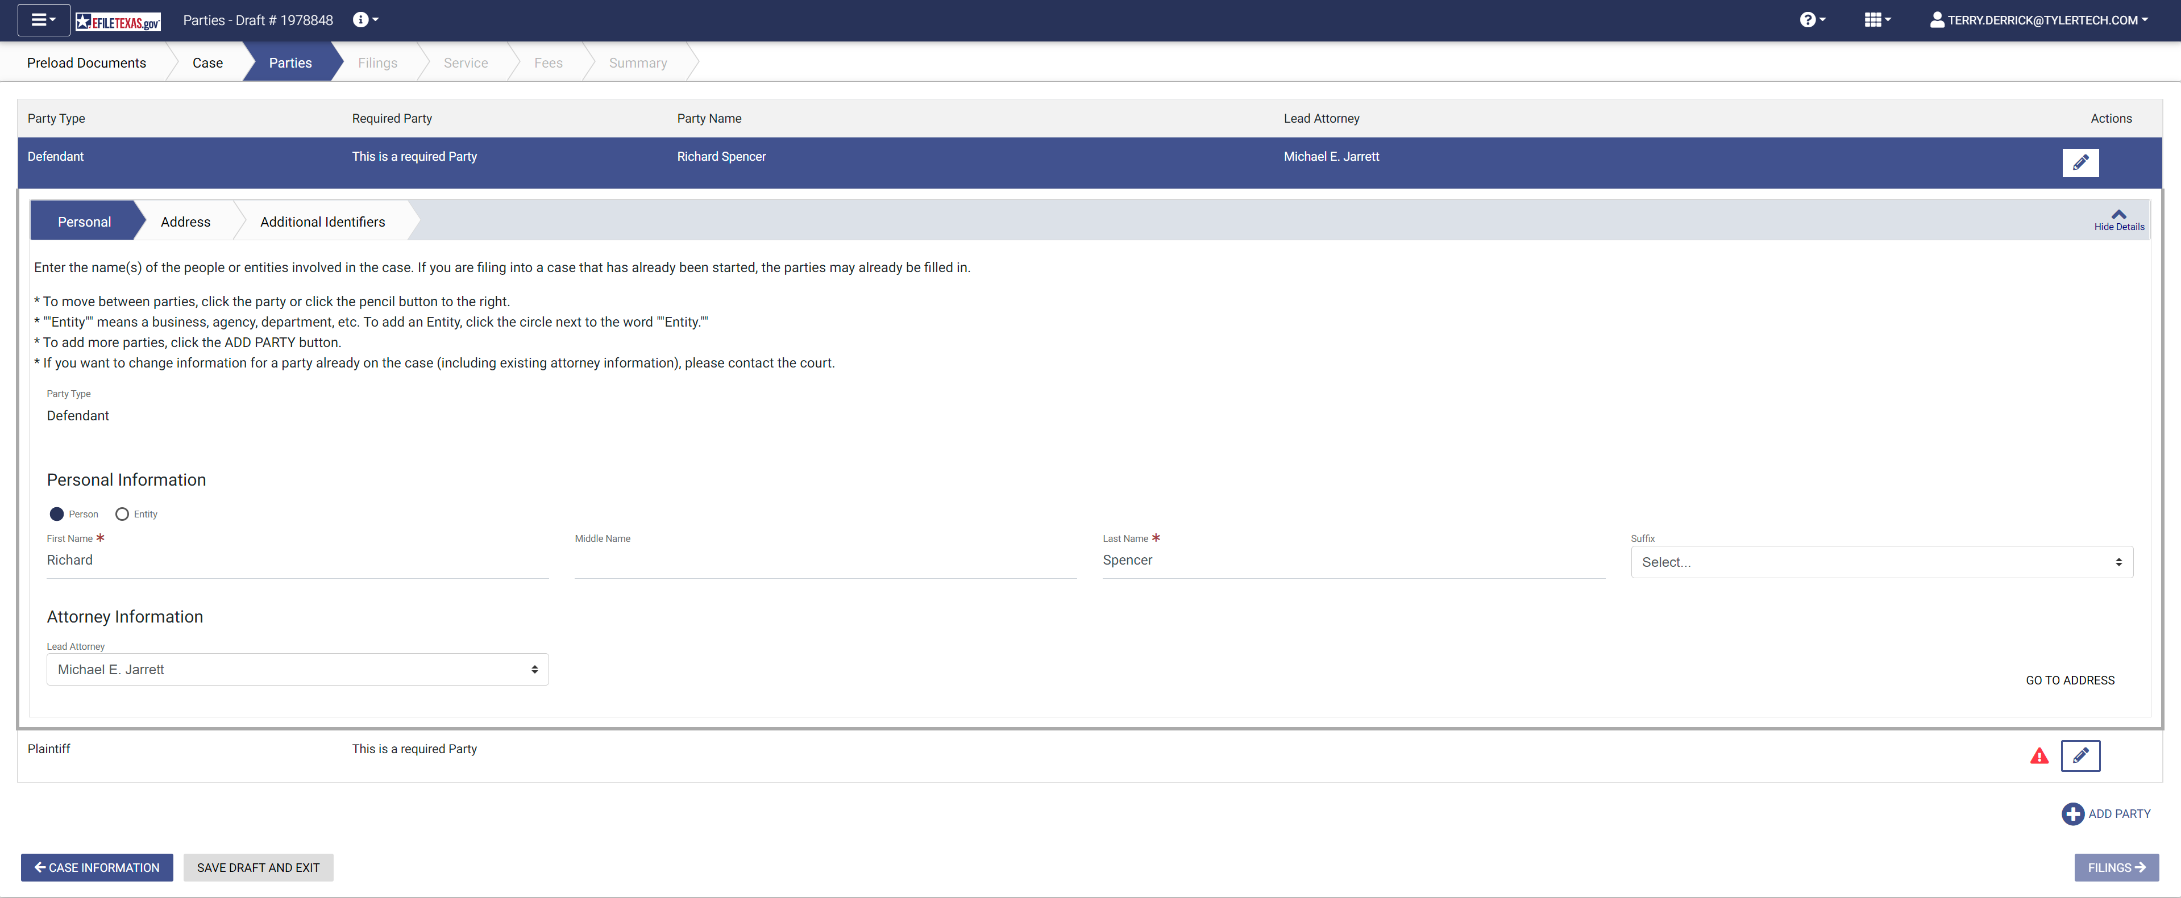
EFSP and EFM Migration to AWS
Migration Tool: State-provided filing portal (EFSP)
Impacted User Community: Filers
Migration (Redirect) Date: 7/31-Production
Communications & Training: Outreach Campaign (6/13 – 7/29) consisting of:
iContact messages (multiple)
In-app notifications in existing portal
Live and recorded training sessions (multiple)
New & existing user notifications
Review application redirect
Migration Tool: eFiling Manager (EFM)
Impacted User Community: Third-Party Integrators
Migration Date: 7/6-Stage; 8/20-Production
Communications & Training:
EFM Compass Checks (multiple)
iContact messages (multiple)
Notes:
EFSP Migration
EFSP v2022.5 contains usability improvements to major e-filing steps (filing details, service contacts page, new user registration)
Community outreach campaign will consist of recurring H5 End-Of-Life messaging to all end users (Important dates, FAQs, links to support articles and training opportunities)
EFSP end user training (both for clerks and filers) will run through the EFSP cutover date
EFM Migration
Leverage EFM Compass Checks to inform integrated partners of important dates and avenue for supporting necessary security changes
Ample runway for integrated partners to validate their security changes against stage, Cloud EFM
Production redirect occurs during maintenance window on 8/20
Revert to Tyler Databank hosted EFM if AWS EFM cutover unsuccessful

Slide 8

re:SearchTX Update
Top Clerk Request
Option to add criminal data
*Many clerks want to retire local solutions but can’t until criminal data is permitted
Top Legal Professional Request
Availability of Judgments/Orders
*Many attorneys find re:Search’s value limited, due to the lack of comprehensive records
Legend
Document Purchase Revenue
Integrated Courts - $106,893
Non-Integrated Courts - $347,656
Clerk
Judges
Attorneys
Registered Users
Notes:
Although user growth between August and November was only 1.5%, the growth of attorney users 6.5%.
6 new counties have asked for the inclusion of criminal records since our last meeting
consistent with our legal professional community where the #1 request is "when will we get criminal data?", followed closely by "When will we get judgments and orders?", which speaks to the integration status. Right now, we only have ~6% of the courts integrated, but the UCMS project could help increase the number of integrated courts
In the last meeting it was asked to provide the document purchase revenue, which you can see from the bottom
On average, integrated courts - $2,400 while non-integrated courts - $400.

Slide 9
Questions?

Slide 10
Appendix

Slide 11
EFM and EFSP Migration to AWS
2022
May
Today
Jun
Jul
Aug
2022
EFSP v2022.5 Release
May 20
Install EFSP v2022.5 to Stage
May 23
EFSP Migration
Jun 13 - Jul 29
Community Outreach Campaign
Install EFSP v2022.5 to Production
Jun 25
Implement H5 Redirect to EFSP
Jul 31
Jul 11 - Aug 12
Live EFSP Training Sessions
Stage EFM Redirect
EFM Migration
Jul 6
Jul 7 - Aug 19
Integrated Partner Validation
Production EFM Migration
Aug 20
Key Dates
July 31 – EFSP redirect (all users will be migrated to new EFSP on this date)
August 20 – eFiling Manager (EFM) will be migrated to AWS GovCloud
Notes:
EFSP Migration
EFSP v2022.5 contains usability improvements to major e-filing steps (filing details, service contacts page, new user registration)
Community outreach campaign will consist of recurring H5 End-Of-Life messaging to all end users (Important dates, FAQs, links to support articles and training opportunities)
EFSP end user training (both for clerks and filers) will run through the EFSP cutover date
EFM Migration
Leverage EFM Compass Checks to inform integrated partners of important dates and avenue for supporting necessary security changes
Ample runway for integrated partners to validate their security changes against stage, Cloud EFM
Production redirect occurs during maintenance window on 8/20
Revert to Tyler Databank hosted EFM if AWS EFM cutover unsuccessful

Slide 12
Clerk Response Rates
Clerks continue to review filings in a timely manner
90.13% of filings are processed in under 24 hours in 2022
Increase of 1.6% in filings processed in under 24 hours, since 2017
Marginal difference between integrated and non-integrated

Slide 13
Clerk Response Rates – Last 3 Months
Response rates are similar between courts of different sizes
In 2021, 90% of all filings were accepted/returned for correction within 24 hours of submission

Slide 14
JP E-Filing Volume
Summary
105,000 Filings Per Month Average
Active Engagements:
  Scurry JP1 & 2
  Freestone JP1
  Chambers JP
  Bexar JP
  Wichita JP
  Taylor JP2
Future Engagements:
  Brazoria JP2-1
  Dallas JP3-2
  Milam JP1
  Gray JP 2 and 4
  Brown JP 1-4
  Ector JP3
  Lamar JP 5-1, 5-2
  Smith JP 1-5

Slide 15
CMS Integration Status
82% of offices live on eFileTexas are integrated w/ their Case Management Systems (543 out of 673)
Integration progress being made with CMS vendors:
  6 CMS vendors have established One-Way integration
  7 CMS vendors have established Two-Way integration

Slide 16
Return for Correction Rates – Last 6 Months
Return for Correction rates average under 6% across the state
  National average is ~8%
Filers and Clerks alike, are comfortable with the e-filing process
*Tracking of top 10 counties (in population) began in September 2018

Slide 17
TX E-Filing: JP
Dallam
Sherman
Hansford
Ochiltree
Lipscomb
Hartley
Moore
Hutchinson
Roberts
Hemphill
Oldham
Potter
Carson
Gray
Wheeler
Deaf Smith
Randall
Armstrong
Donley
Collings-
worth
Parmer
Castro
Swisher
Briscoe
Hall
Childress
Hardeman
Summary
Bailey
Lamb
Hale
Floyd
Motley
Cottle
Wilbarger
Wichita
Foard
Cochran
Hockley
Lubbock
Crosby
Dickens
King
Knox
Baylor
Archer
Clay
Montague
Cooke
Grayson
Fannin
Lamar
Red River
166 precincts across 43 counties are live
6 active engagements
8 engagements pending
Delta
Bowie
Yoakum
Terry
Lynn
Garza
Kent
Stonewall
Haskell
Throck-
morton
Young
Jack
Wise
Denton
Collin
Hunt
Hopkins
Franklin
Titus
Morris
Cass
Gaines
Dawson
Fisher
Jones
Shackel-
ford
Stephens
Palo Pinto
Parker
Tarrant
Dallas
Rock-
wall
Rains
Wood
Camp
Marion
Borden
Scurry
Kaufman
Van
Zandt
Upshur
Harrison
Andrews
Martin
Howard
Mitchell
Nolan
Taylor
Callahan
Eastland
Hood
Johnson
Ellis
Smith
Gregg
Erath
Somer-
vell
Hill
Navarro
Henderson
Rusk
Panola
El Paso
Loving
Winkler
Ector
Midland
Glasscock
Sterling
Coke
Runnels
Coleman
Brown
Comanche
Bosque
Anderson
Cherokee
Shelby
Hudspeth
Culberson
Ward
Crane
Mills
Hamilton
McLennan
Limestone
Freestone
Nacogdoches
Reeves
Upton
Reagan
Irion
Tom Green
Concho
Mc
Culloch
San
Saba
Coryell
Falls
Leon
Houston
Angelina
San Augustine
Sabine
Lampasas
Bell
Robertson
Madison
Trinity
Jasper
Jeff Davis
Pecos
Schleicher
Menard
Mason
Llano
Burnet
Milam
Polk
Tyler
Newton
Crockett
Sutton
Kimble
Williamson
Burleson
Brazos
Grimes
Walker
San
Jacinto
Orange
Terrell
Gillespie
Blanco
Travis
Lee
Washington
Waller
Montgomery
Liberty
Hardin
Presidio
Val Verde
Edwards
Kerr
Kendall
Hays
Bastrop
Austin
Brewster
Real
Bandera
Comal
Caldwell
Fayette
Colorado
Harris
Jefferson
Medina
Bexar
Guadalupe
Gonzales
Lavaca
Fort Bend
Chambers
Kinney
Uvalde
Wilson
Wharton
Brazoria
Zavala
Frio
Atascosa
Karnes
DeWitt
Jackson
Galveston
Maverick
Goliad
Victoria
Legend
Dimmit
La Salle
McMullen
Live Oak
Bee
Refugio
Calhoun
Matagorda
Live
Aransas
Not Live
Webb
Duval
Jim Wells
San Patricio
Nueces
Jim Hogg
Kleberg
Zapata
Brooks
Kenedy
Note: Not all live counties are live with all precincts
Starr
Willacy
Hidalgo
Cameron

